Slide 1

RETAIL ALERT
A NEW WAY TO SHOP!

Slide 2
WHO ARE WE?
Boss-Mendoza Incorporated
Brandon Boss
In the hospitality industry for over 5 years
Junior software engineer for over 3 years
Mayra Mendoza
Retail manager for over 8 years
Retail worker for over 10 years

Slide 3
WHO ARE YOU?
Who you might be:
An investor looking to partner with many retail chains nationwide
A retail owner looking to compete with online retailers, boost sales and decrease labor costs while improving efficiency of your current employees
An advertiser looking to partner with us and have your targeted advertisements seen by the right audience
Who you definitely are:
Someone who has shopped in stores and:
Owns a smartphone
Has had at least one bad experience in a retail store waiting for assistance from employees

Slide 4
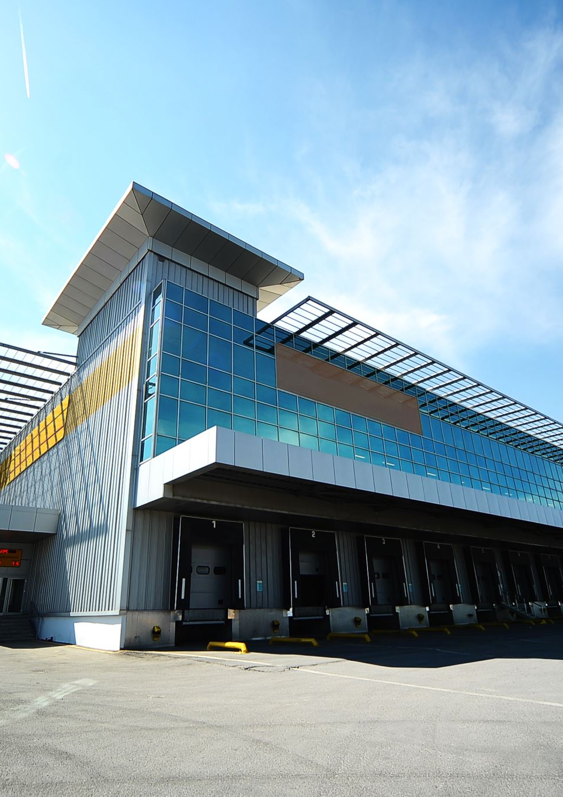
THE PROBLEM FOR BUSINESSES
Nearly 9,000 store closings in 2019
People are buying more online than they used to (see next slide)
Cost to keep a business open is much higher with factors like rent and cost of labor, which only keep going up
Stores are messier and unkempt

Slide 5
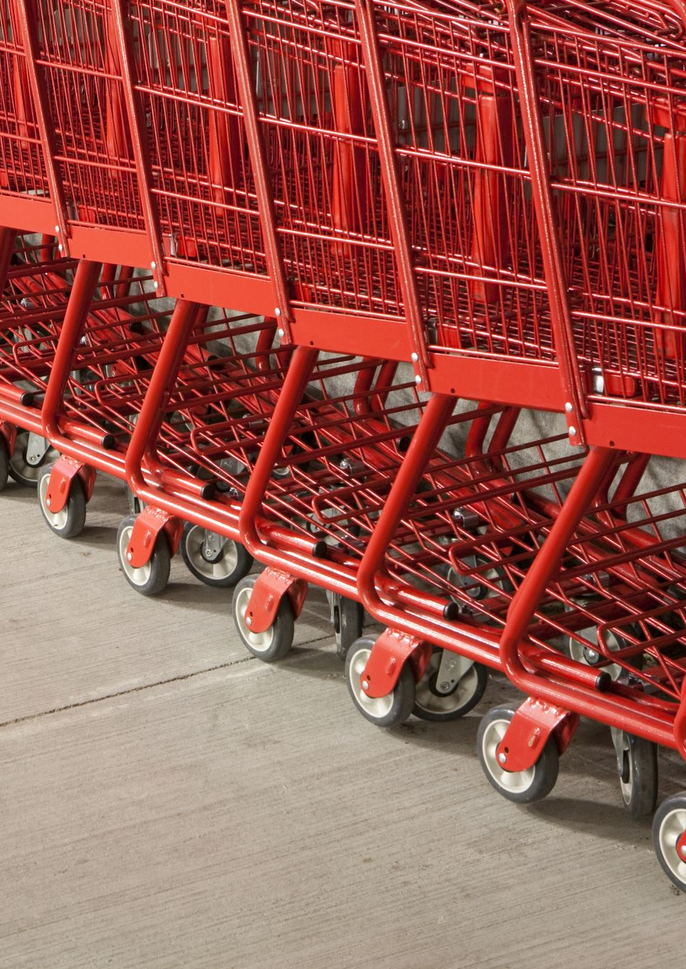
THE PROBLEM FOR CONSUMERS
Online shopping experience vs in store
Online consumers like the ease in which one can find the product for which they are looking (88%)
They like the breadth of product choices (84%)
Majority of Americans who shop online (56%) prefer to shop in a brick and mortar store
Millennials have a much higher demand for instant gratification than older generations. Although younger consumers are increasingly comfortable with buying products online without seeing them first, they are almost twice as likely to say they’d rather visit shops to get their product right away, rather than buy online and await delivery. (KPMG)

Slide 6


INTERVIEWS FROM RETAILERS
How can technology be used to create a more efficient shopping environment?
What are some ways that technology can make your job easier?
“Sometimes there are too many customers who all want help at once. I would like to help them all, and I think finding an easy way to communicate that I will get to them in a first come, first served basis would be very helpful. It is almost impossible to help them all at once.”
“If technology could answer some basic questions then I could focus on my job without being distracted. If we are out of stock, I must check in back or look up my inventory. This process would be much easier if the customer could check for themselves. I often find that I am stopping what I am doing to log into my computer to check stock for other stores. This is time consuming.”

Slide 7


INTERVIEWS FROM CUSTOMERS
How can technology be used to create a more efficient shopping environment?
What are the main reasons you shop in a store as opposed to shopping online?
“Sometimes it’s really difficult to find someone to help. I just want to get my things and go, but there is no one around to help or they are busy helping another customer already.”
“I need to try things on. I need things quickly, and shipping takes a while. If I decide I want something, I want it now. I like to feel, touch and see the items I am going to buy. Online shopping is complicated due to returns. “

Slide 8
QUANTITATIVE DATA: RETAILERS
Question | Strongly Agree | Somewhat Agree | No Opinion | Somewhat Disagree | Strongly Disagree
I spend a lot of time looking for a customer that needs assistance. | 83% | 10% | 5% | 3% | 4%
It would be helpful to me if customers could check the products we have on hand without my assistance. | 67% | 23% | 4% | 4% | 2%
It would be helpful to me if customers could retrieve information about variations and availability of a product without my assistance. | 85% | 10% | 3% | 0% | 2%

Slide 9
QUANTITATIVE DATA: CUSTOMERS
Question | Strongly Agree | Somewhat Agree | No Opinion | Somewhat Disagree | Strongly Disagree
I spend a lot of time waiting for a store associate to help me. | 80% | 5% | 5% | 10% | 0%
Sometimes I go to a store and they don’t have what I want in stock. | 63% | 24% | 4% | 4% | 5%
Sometimes I wait a long time for an associate’s assistance for a simple question. | 74% | 10% | 6% | 5% | 5%

Slide 10
THE SOLUTION: RETAIL ALERT
What is Retail Alert?
An app for customers and retail employees alike, smartphone required
A solution to the issues presented that shy many customers away from in store shopping
A way for employees to work more efficiently, therefore allowing businesses to not have to spend as much on labor expenses

Slide 11




HOW WILL RETAIL ALERT MAKE MONEY?
Targeted ads/Ad free
Advertisers will pay for their ads to show up on our app, or users will pay to remove ads
Coupons
Brands will pay for coupons related to customer searches
Investors
We are relying partially on investors to help fund our app
Retail buy in
We will charge a nominal service fee to retail stores for our services

Slide 12
IN DEPTH
Targeted ads/Ad free
We will employ a ‘cost per click’ model on our targeted advertisements, at a reasonable $1-$2 per ad, depending on the ad quality and ad bid
We will give customers the option to remove ads for a one-time $2 payment
Coupons: monthly buy in
We will use a monthly $50 promotion plus the cost of the coupon
Retail buy in
Retailers will be charged on a cost per customer basis, so as not to favor larger retailers or turn off smaller ones
We will charge $1 per customer that uses the features of the app at the retail store
Investors
Join in for as little as $500

Slide 13

WHAT DOES OUR APP DO?
Retail Alert features:
Customer management
Targeted advertisement
Product information lookup
Product pickup
Store map
Quick help

Slide 14
CUSTOMER MANAGEMENT
The customer will be able to:
indicate that they need assistance (add self to assistance queue)
can include a note describing their request
while queued
notified when an associate is coming to help them (similar to queuing for an Uber)
Can see how long they’ve been queueing
Is served targeted advertisements
cancel an assistance request (remove self from assistance queue)
The associate will be able to:
assist customers (remove customers from queue)
access information about the customer’s request
the request, where they are and how long they’ve been waiting
The System will:
maintain a queue of customer objects
Each object includes
How long they’ve been waiting
The customer’s location
The customer’s request
Allows users to perform the previously listed operations on the queue
serve targeted advertisements to enqueued customers
Notify customers when an associate is on their way
Notify associates when a new customer has entered the queue

Slide 15
PRODUCT INFORMATION LOOKUP
The customer will be able to:
Scan barcodes to search for an item
Search for an item
By typing the item name, sku, upc or description into a search bar
Either return to the search and be able to attempt a search again or have the option of being taken to customer management OR quick product help if the search doesn’t pull any results
Get information (from scanning a barcode or searching for an item) on whether an item is available or out of stock
Easily be able to move from product information lookup use case to customer management OR quick help use cases at the click of a button (when necessary)
The System will be able to:
Maintain a database of product information
This database should be tied to a barcode, sku or upc
This database should be searchable through various keywords
This database should show the quantities available of that item
Be able to list the specific quantities of an item
When searching for an item, should give me the location of that item in the store
If the items are not actually located there, there needs to be a quick way for the app to switch from product lookup to customer management or quick help

Slide 16
Prototype
Video Walkthrough
Retail Alert

Slide 17
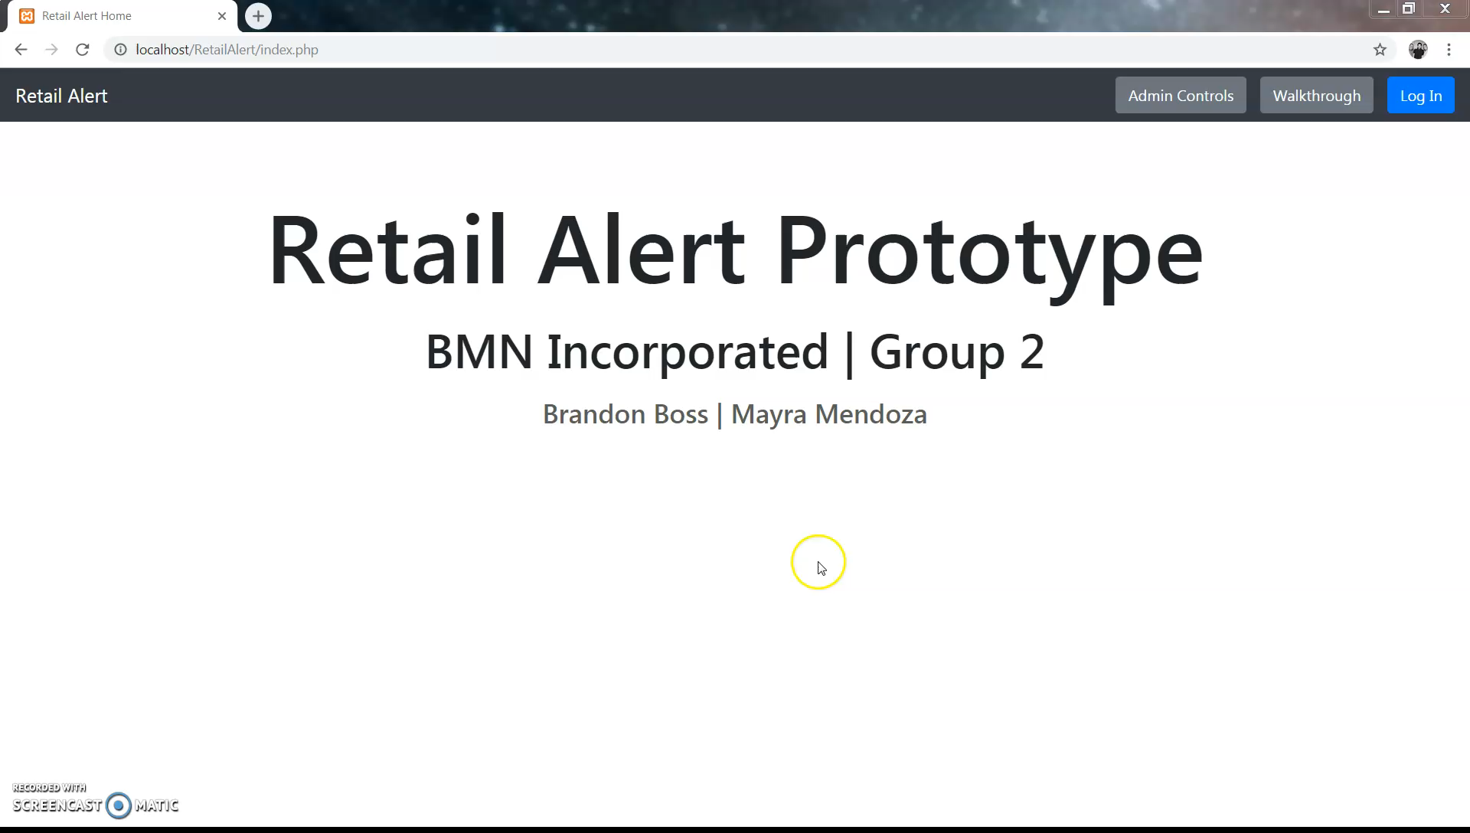

Slide 18
OTHER FEATURES (in development)
Targeted advertisements
Coupons related to shopping habits or searches
Intelligent related products based on search history or purchase history
Product pickup
Search through other store’s inventory to locate a desired item
Place an item on hold to pick up at desired store location
Store map
Quick map of the retail store for ease of locating products
Quick help
Message/chat feature to get quick assistance to easy questions
Support based assistance that doesn’t require an in-person experience
Answers to simple questions like: “does this come in a different size or color?”

Slide 19
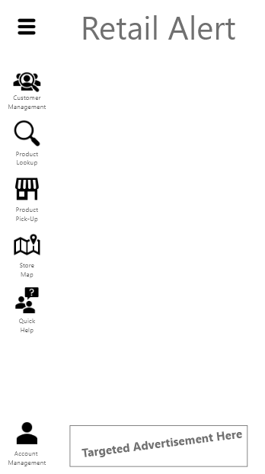
Next Steps
Once every feature has been prototyped and tested, we will begin development of the final product
The final product will have a UI similar to the image on the right
We plan to begin a closed beta in early 2020
We plan to launch a full release before the end of 2020

